Slide 1




Week-1 (Discussion)
25th Jul, 2025
Computer Vision
Prof. Jayanta Mukhopadhyay
Professor
Computer Science and Engineering Department
IIT Kharagpur
Ayan Paul
PMRF Research Scholar
IIT Kharagpur

Slide 2
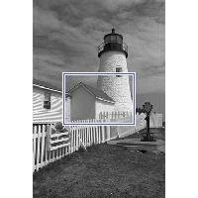
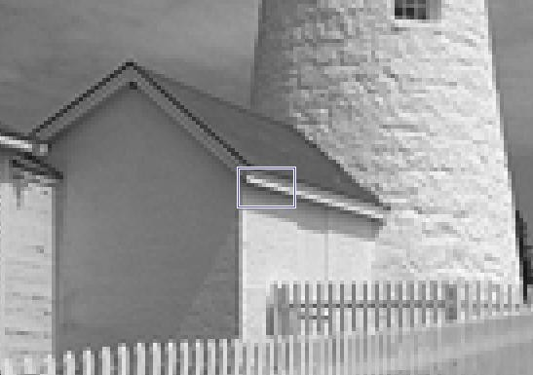
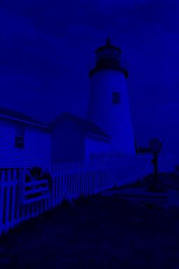
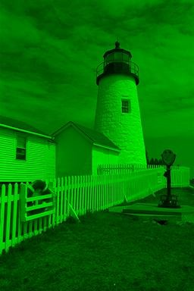
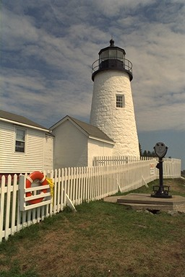
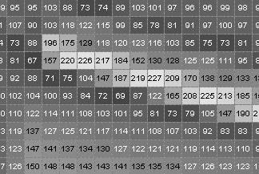

Fundamentals of Image Processing
In computer vision, an image is a structured array of pixel values that represent visual information captured from the real world.
Pixel: The smallest unit of an image, representing color or intensity. For a color image: pixel = [R, G, B].
Each pixel in the image holds intensity
An image is represented as a matrix or tensor.
Color (RGB) images
Width: 256
Height: 384
B
G
R
A 2D Array of integers
Types of Images
Grayscale Image: Each pixel has a single intensity value (0–255).→ Shape: (height, width)
RGB Image: Each pixel has three values (Red, Green, Blue), usually in the range 0–255.→ Shape: (height, width, 3)
Multispectral / Hyperspectral Image: More than 3 channels (used in satellite, agricultural imaging, etc.).
Binary Image: Each pixel is either 0 or 255 (black or white).

Slide 3
Image File
An image file is a digital representation of a visual scene stored on a computer.
Header | 100 | 101 | 88 | Stream of pixels | EOF
width | height | # Comp. | # bytes/pixel
1. Header: The header contains metadata about the image.
This information is necessary to correctly interpret the pixel data that follows.
Field | Meaning
width | Number of pixels along the x-axis
height | Number of pixels along the y-axis
# Comp. | Number of color components (e.g., 3 for RGB)
bytes/pixel | Number of bytes used per pixel (usually 1byte/pixel)
Other | Compression type, color space, etc.
2. Stream of Pixels: After the header, the actual image data (pixels) is stored.
This is typically a long stream of bytes or values that represent pixel colors in a specific order
3. EOF (End of File): This marks the end of the image data.
It tells the system or program that no more pixel data follows.

Slide 4
Standard Image File Formats
Format | Full Form | Compression Type | Characteristics | Typical Use Case
BMP | Bitmap Image File | Uncompressed / RLE | Simple format, large file size, no compression artifacts | Teaching, raw pixel analysis, Windows OS compatibility
JPEG | Joint Photographic Experts Group | Lossy | Very high compression, quality loss, adjustable compression ratio | Photography, datasets like ImageNet
PNG | Portable Network Graphics | Lossless (DEFLATE) | Supports transparency (alpha channel), no quality loss | Segmentation masks, medical imaging, web graphics
GIF | Graphics Interchange Format | Lossless (LZW) | Limited to 256 colors, supports basic animations and transparency | Simple animations, web graphics
TIFF | Tagged Image File Format | Lossy/Lossless | Very flexible, supports multiple pages/layers, metadata-rich | Medical imaging, remote sensing, document scanning
PGM | Portable GrayMap | None (raw/ASCII) | Grayscale image, simple structure | Image processing, research, OpenCV/Matlab input
PPM | Portable PixMap | None (raw/ASCII) | Color image format, easy to parse, no compression | Teaching, research, synthetic data
PBM | Portable BitMap | None (raw/ASCII) | Binary (black and white) images only | Old-school formats, quick binary image prototyping
PNM | Portable aNyMap (PBM/PGM/PPM umbrella) | None | Generic wrapper format combining PBM, PGM, and PPM | NetPBM tools, research
WEBP | Web Picture Format | Lossy/Lossless | Smaller than PNG/JPEG, supports transparency and animation | Modern web use, ML web apps
HEIF/HEIC | High Efficiency Image Format / Codec | Lossy/Lossless | Superior compression to JPEG, used in iOS devices | iPhone photos, modern mobile apps
DICOM | Digital Imaging and Communications in Medicine | Lossless/Lossy | Contains both image data and metadata (patient info, scan type, etc.) | Medical imaging (X-rays, MRI, CT scans)
RAW | Raw Image Format | None / Proprietary | Direct sensor data from digital cameras, varies by manufacturer | Professional photography, scientific image capture

Slide 5
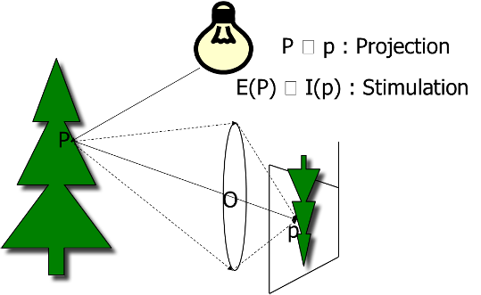
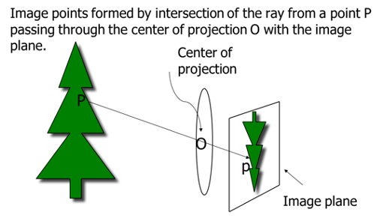
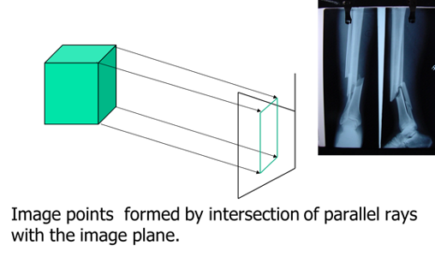
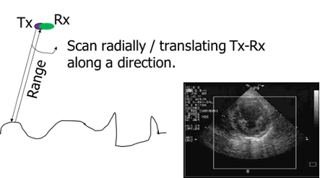
Geometric Definition of an Image
Image formation in optical camera
An image is an impression of the physical world — a spatial distribution of a measurable quantity, encoding the geometry and material properties of objects.
Rules of projection
Perspective projection
Parallel projection
Other imaging principle

Slide 6
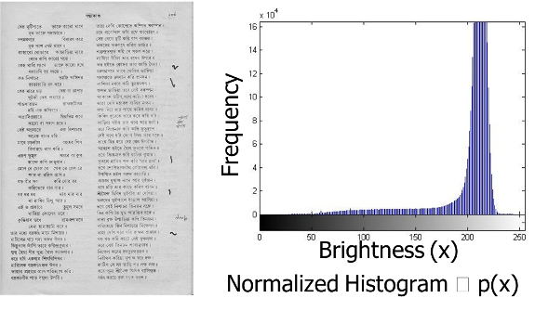
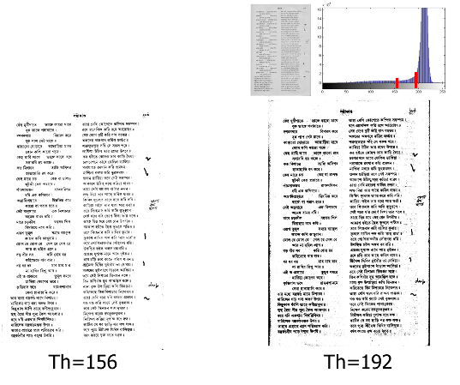
A few concepts and operations
Image histogram
An image histogram is a graphical representation of the distribution of pixel intensities (brightness or color values) in an image.
It shows how many pixels in an image have a certain intensity value
Binarization
Binarization is the process of converting a grayscale image into a binary image, where each pixel is set to either 0 or 255.
How It Works:
Foreground: The part we care about (e.g., text, object, shape). → Represented by dark pixels (0)
Background: The surroundings or area we want to ignore. → Represented by bright pixels (255)
Thresholding (Binarization with some threshold)
Convert image to grayscale.
Choose a threshold value (e.g., 127).
Apply rule:
If pixel value < threshold → 0 (black) → foreground
If pixel value ≥ threshold → 255 (white) → background

Slide 7
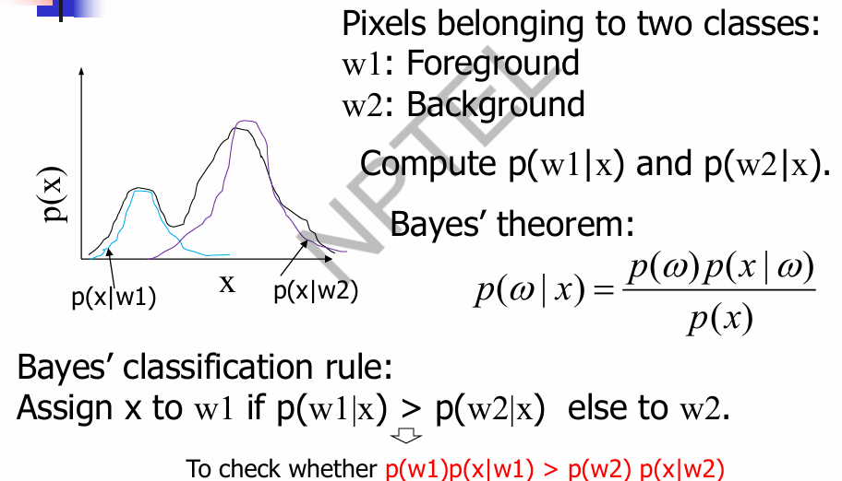
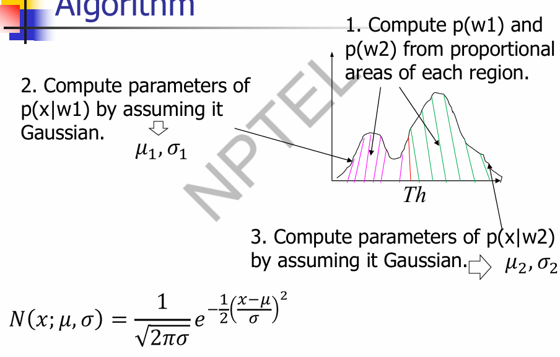
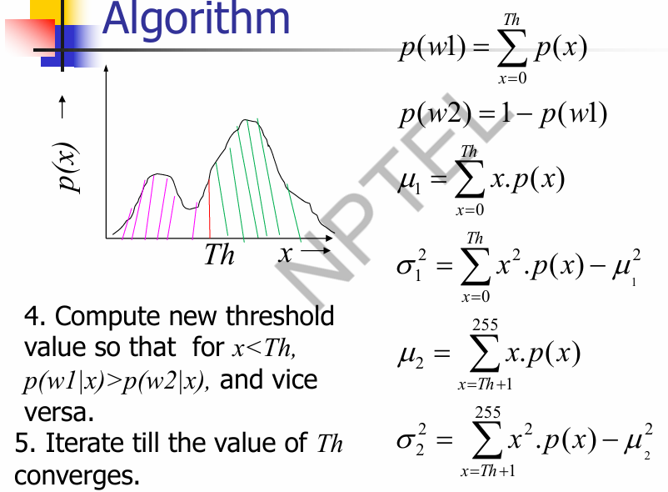
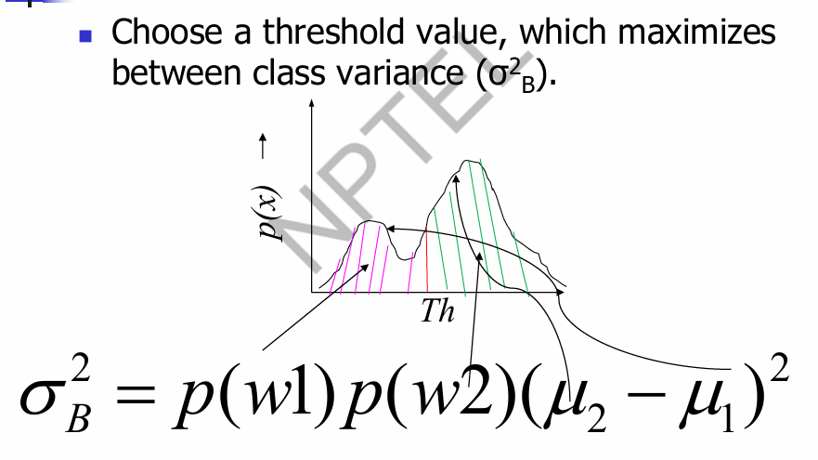
Automating Thresholding
Bayesian Classification of foreground and background pixels
Expectation-Maximization
Otsu Thresholding

Slide 8
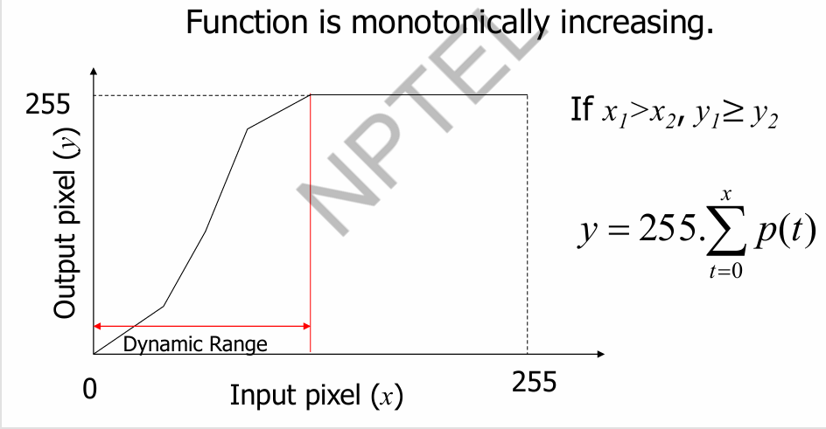
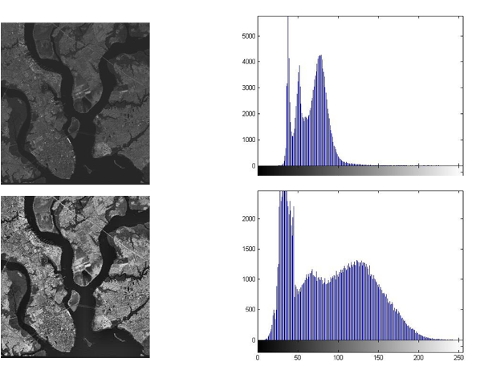
Contrast Enhancement: Pixel mapping
Pixel mapping means converting each original pixel intensity to a new intensity to improve contrast — done through a mapping function that is derived from the image histogram
Histogram Equalization
Histogram equalization is a contrast enhancement technique in image processing that redistributes the intensity values of pixels so that they spread more uniformly across the available range

Slide 9
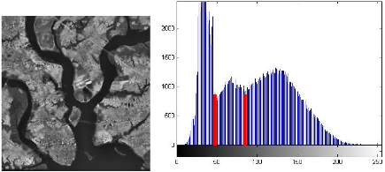
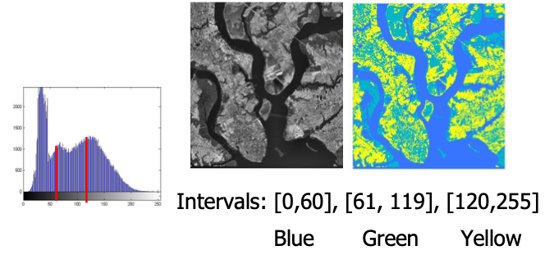
Segmentation
Segmentation is the process of partitioning an image into non-overlapping, meaningful sets of pixels that correspond to distinct structures or regions.
The key idea is to group pixels with similar properties so that each group corresponds to a meaningful structure in the image (e.g., an object, background, edge, etc.).
Binarization is the simplest form of image segmentation, where an image is divided into just two regions:
Foreground (e.g., text, object) → usually represented by 0 (black)
Background (e.g., white space) → usually represented by 255 (white)
Purpose: To simplify the image and highlight important structures like text or objects.
Multilevel thresholding
Multilevel thresholding extends binarization to segment an image into multiple regions, not just two.
Instead of one threshold T, it uses multiple thresholds (e.g., T₁, T₂, …).
Pixels are assigned different labels or gray levels based on which interval their intensity falls into.

Slide 10
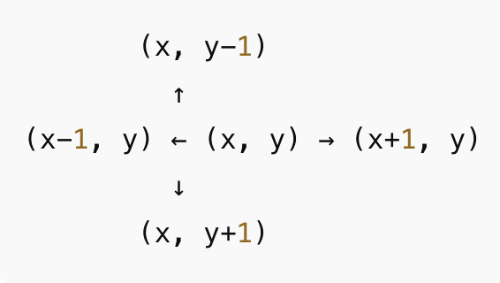
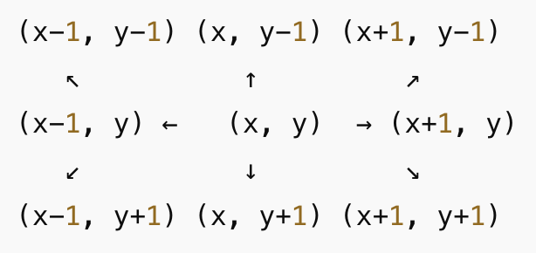
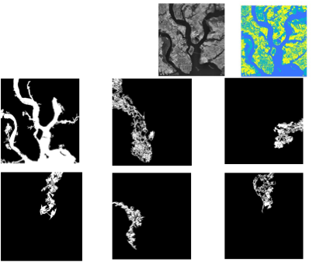
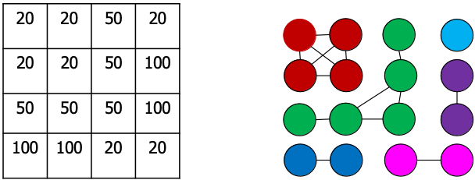
Component Labeling
 | o
o | o | o
 | o
o | o | o
o | o | o
o | o | o
In image processing, the neighborhood of a pixel refers to the set of surrounding pixels used to perform operations like filtering, segmentation, edge detection, or connectivity analysis.
Component labeling is the process of identifying connected regions (components) in an image where neighboring pixels share the same label or intensity (e.g., same value like 20 or 50).
Treat the image like a graph:
Each pixel is a node.
Edges are formed between neighboring pixels that have the same intensity.
4-neighbors
8-neighbors

Slide 11
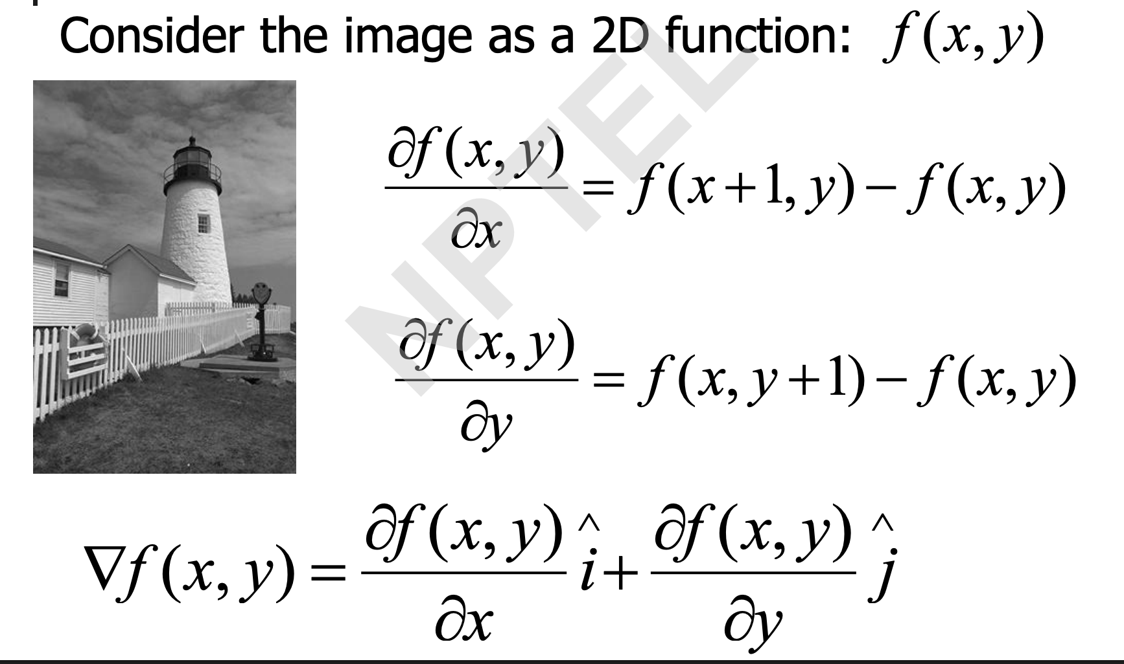
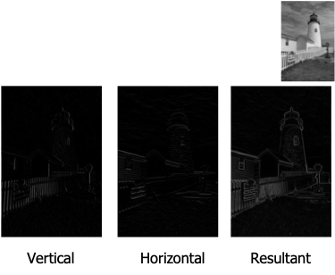
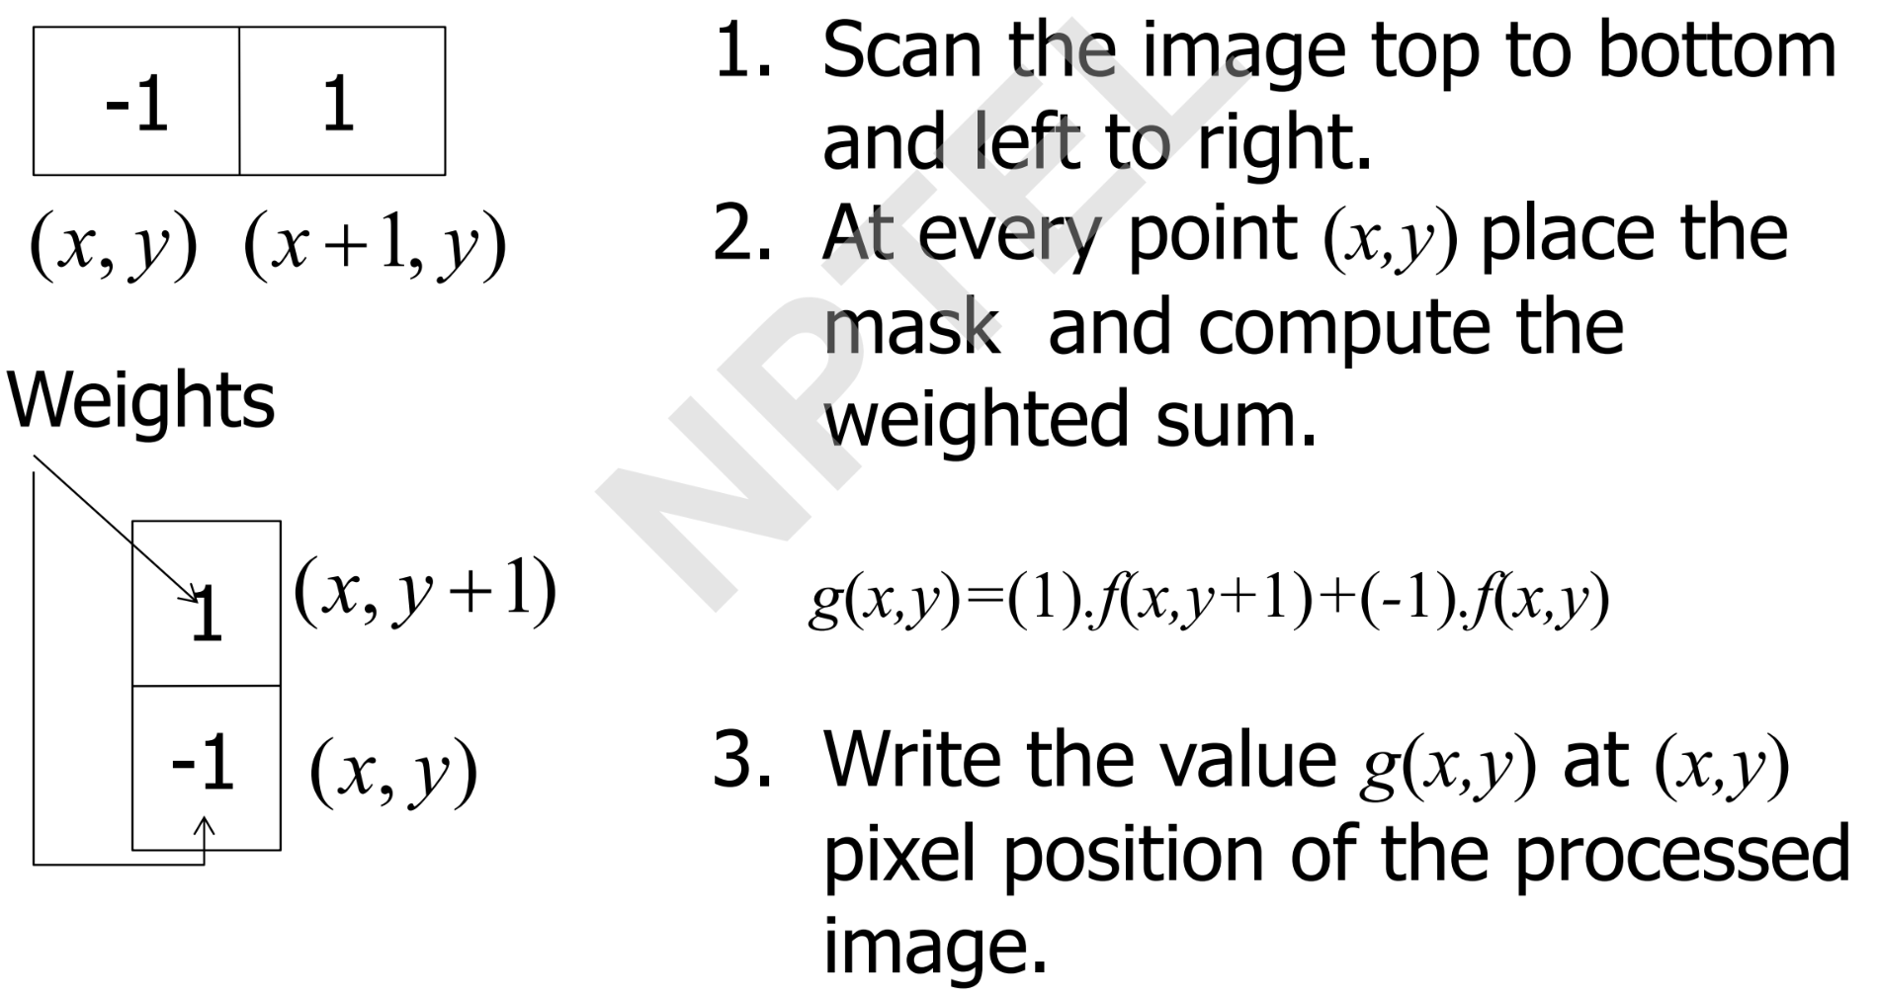
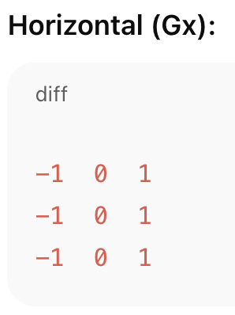
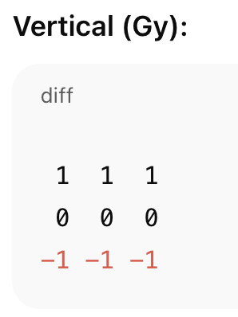
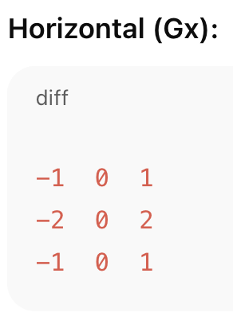
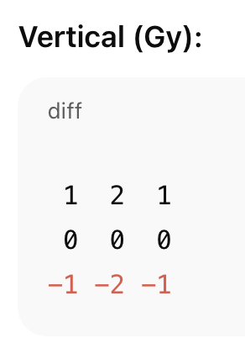
Gradient Operations
In image processing, gradients represent changes in intensity – essentially, edges. To find edges, we use derivative masks (filters) to compute the rate of change in pixel intensity.
We apply a convolution operation between the image and a mask to highlight vertical or horizontal edges.
Computation with a mask
Prewitt Operator
Sobel Operator
Simple averaging of neighboring gradients (equal weight).
Two Prewitt kernels: One for horizontal, one for vertical edge detection.
Weighted averaging of neighboring gradient values.
Two Sobel kernels: One for detecting vertical edges, the other for horizontal.
Sobel is more robust to noise because it gives more importance to central pixels (with higher weight: 2x).
The label “8 times of the gradient” refers to the maximum value a kernel can produce when applied to an image patch
All rows/columns in each direction have equal weight (i.e., no emphasis on center).
Total maximum gradient here is 6

Slide 12
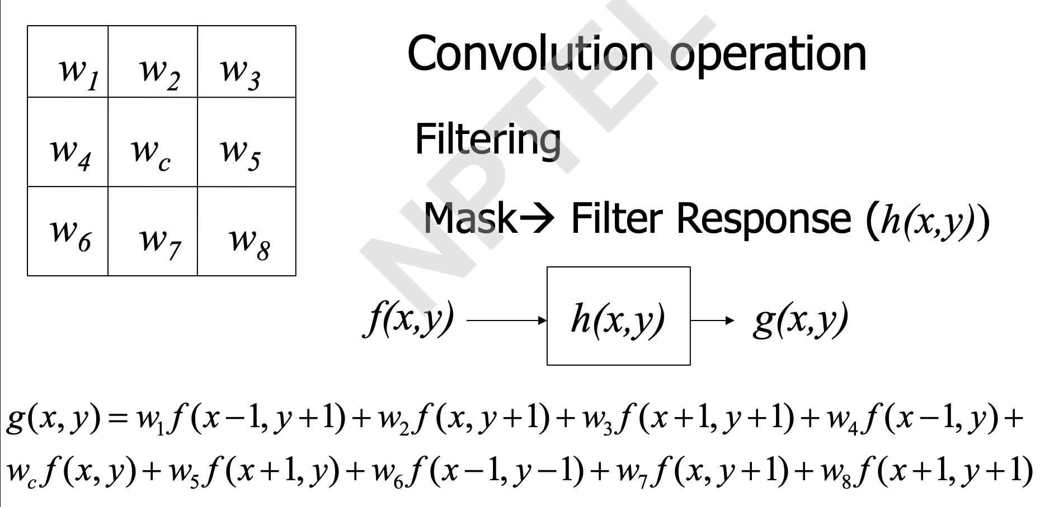
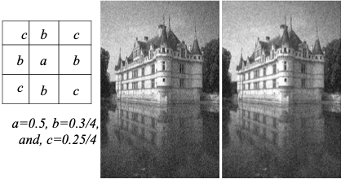
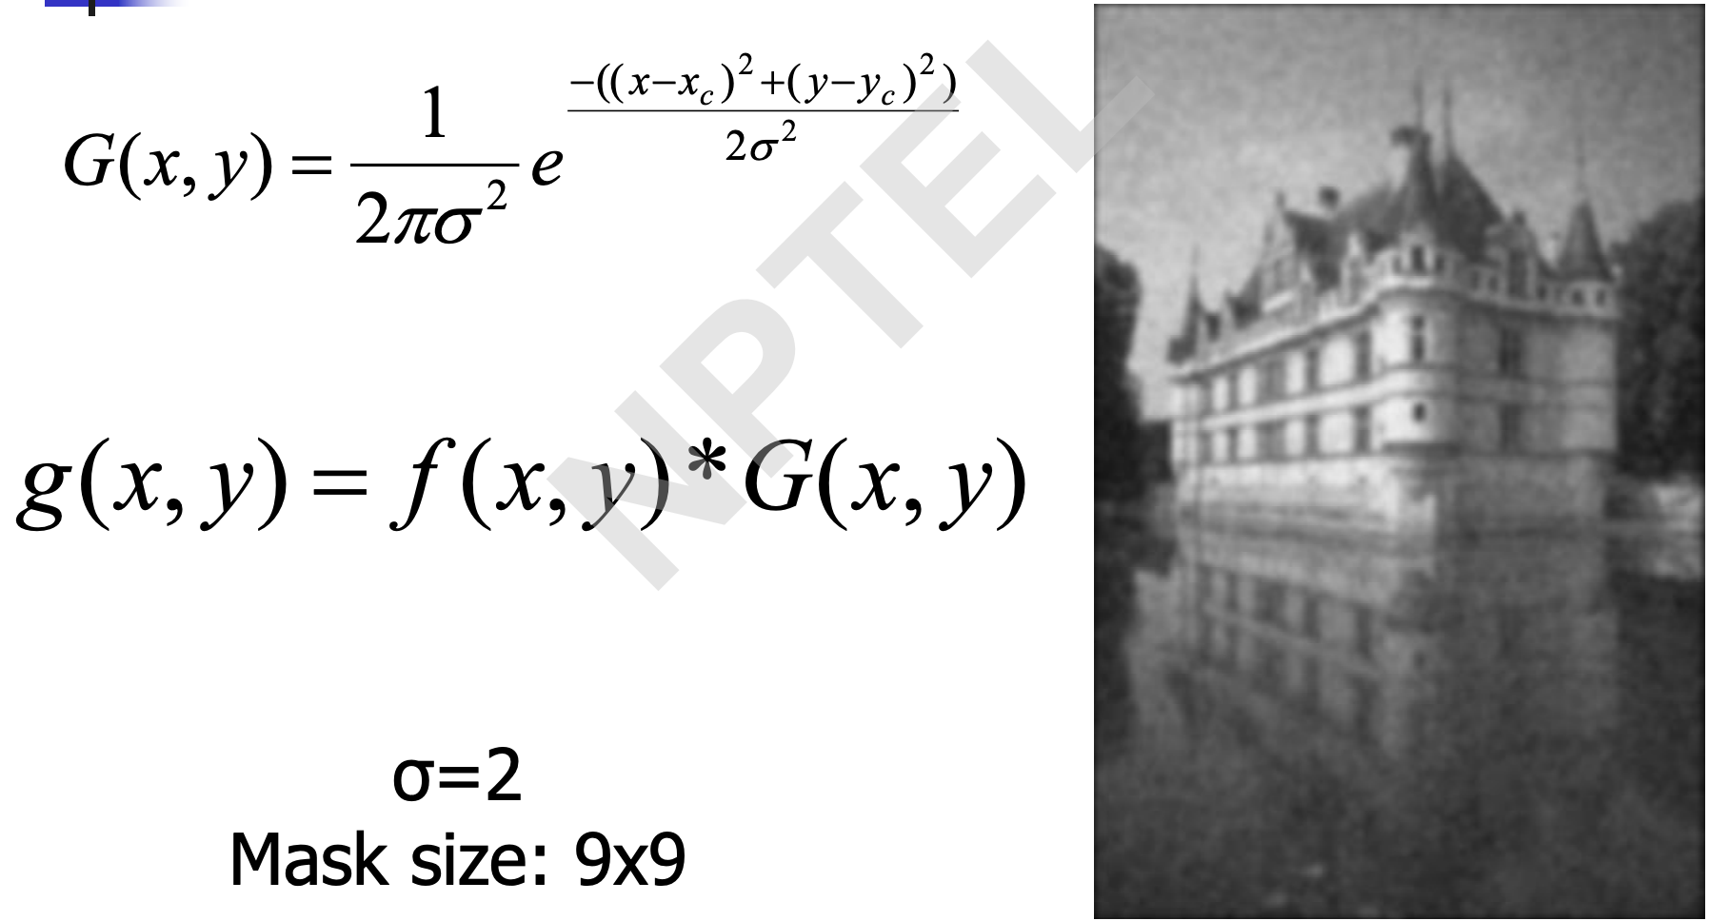
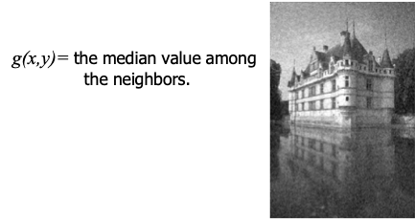
More on computation with mask
Noise Filtering
Techniques aims to reduce noise in an image
Custom Weighted Average Filtering
Gaussian Smoothing
Median Filtering
Method | Best For | Preserves Edges | Removes Outliers | Blurring Effect
Weighted Average Filter | General noise | Moderate | Moderate | Low
Gaussian Smoothing | Gaussian (random) noise | Moderate | Poor | Moderate
Median Filtering | Salt-and-pepper noise | High | Excellent | Low

Slide 13
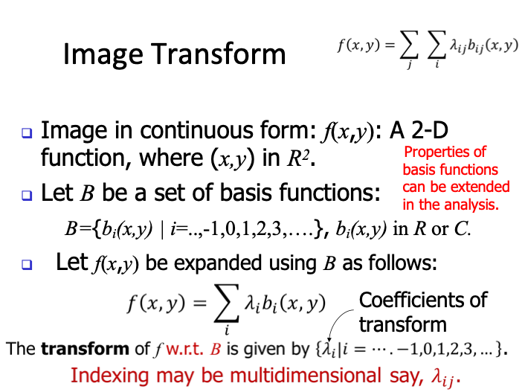
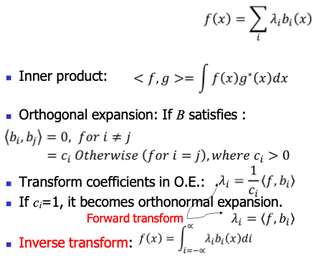
Image Transforms
An image transform is a mathematical operation that converts an image from one domain to another — typically from the spatial domain (pixels) to the frequency domain or another domain for easier analysis or processing.
Purpose:
Simplify complex operations (e.g., filtering, compression).
Extract meaningful features (edges, frequencies).
Make some operations faster (like convolution becomes multiplication in frequency domain).
Orthogonal Expansion
Orthogonal expansion expresses a signal/image as a sum of orthogonal basis functions. “Orthogonal” means the basis functions are independent (like sine and cosine in Fourier).
Think of it like writing any vector as a sum of x, y, and z components — just in image terms.

Slide 14
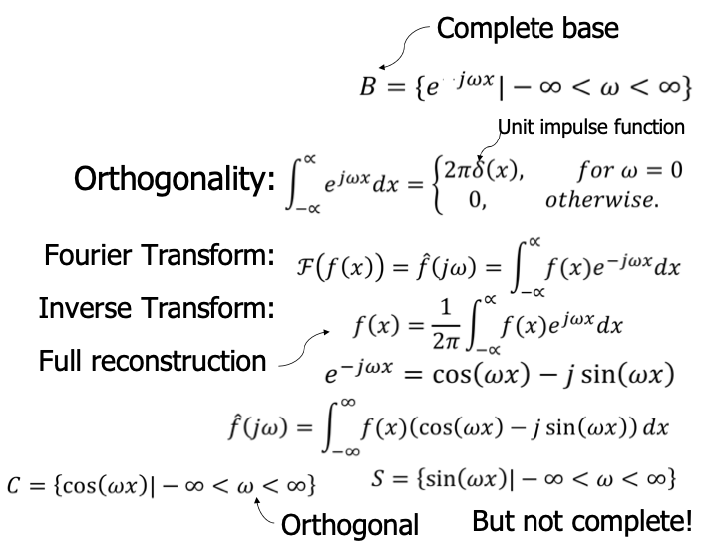
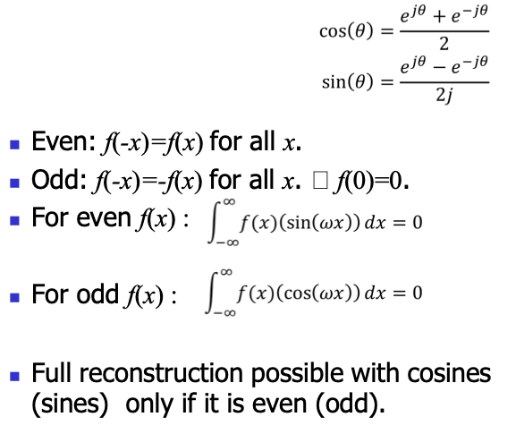
Fourier transform
The Fourier Transform converts a signal/image from the time/spatial domain to the frequency domain, expressing it as a sum of sine and cosine waves.
Purpose:
To analyze which frequencies are present in a signal/image and how strong they are.
Concept of even and odd functions and how they relate to Fourier analysis

Slide 15
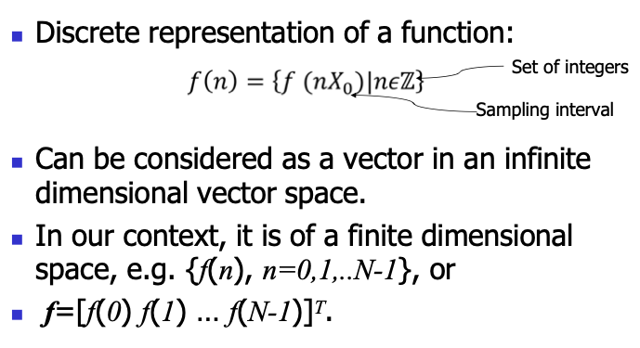
Discrete representation
A discrete representation of a function means we are taking samples of a continuous function at regular intervals and storing them as a list or vector of values.
Why Use Discrete Representation?
In real-world applications:
We can't store or compute with continuous functions.
Instead, we take samples and store them as vectors or arrays.
Discrete Linear Transform
A Discrete Linear Transform is any transformation that:
Works on discrete data (pixels, samples).
Is linear — i.e., follows rules like additivity and scaling.
Includes transforms like:
Discrete Fourier Transform (DFT)
Discrete Cosine Transform (DCT)
Purpose:
To convert discrete signals/images into representations that are easier to analyze, compress, or filter.

Slide 16


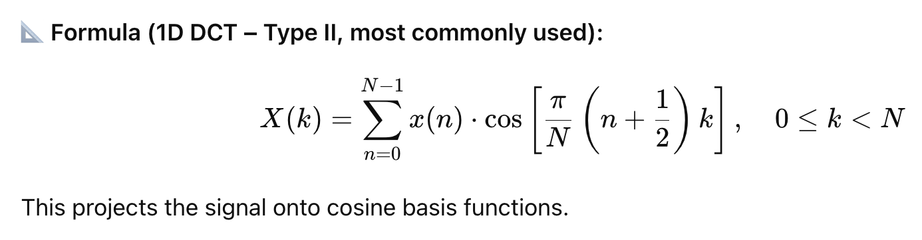
Discrete Fourier Transform (DFT)
The DFT is a discrete version of the Fourier Transform, applied to digital signals or images.
Purpose:
Identify frequency components in digital data.
Used in image and signal processing when working with digital (sampled) data.
Discrete Cosine Transform (DCT)
The DCT is a transform used to express a finite sequence of data points as a sum of cosine functions oscillating at different frequencies.
Unlike DFT, it uses only cosine terms, which makes it suitable for signals with even symmetry and real values.
Purpose:
Captures energy compaction: most of the signal’s energy is concentrated in the first few coefficients.
Ideal for compression since many higher-frequency components can be discarded with little loss of quality.

Slide 17
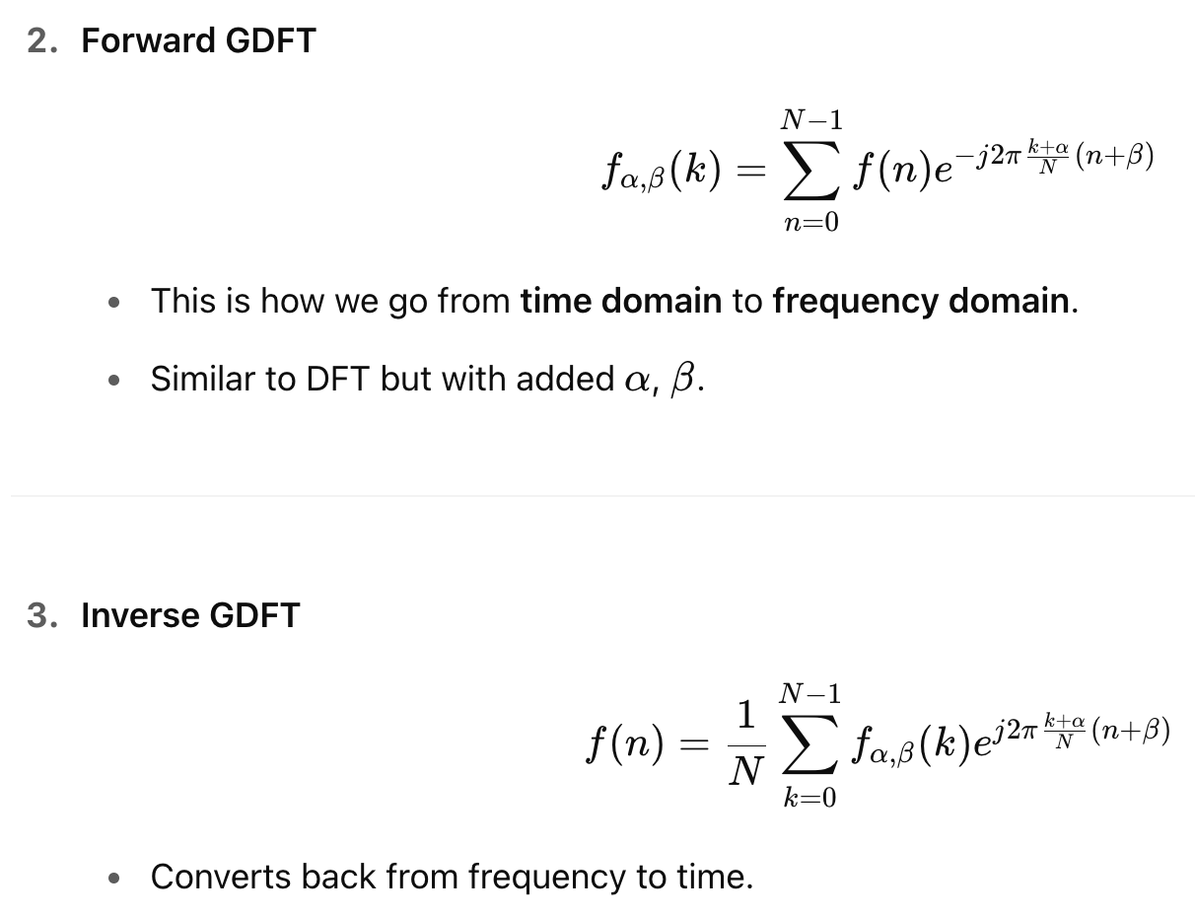
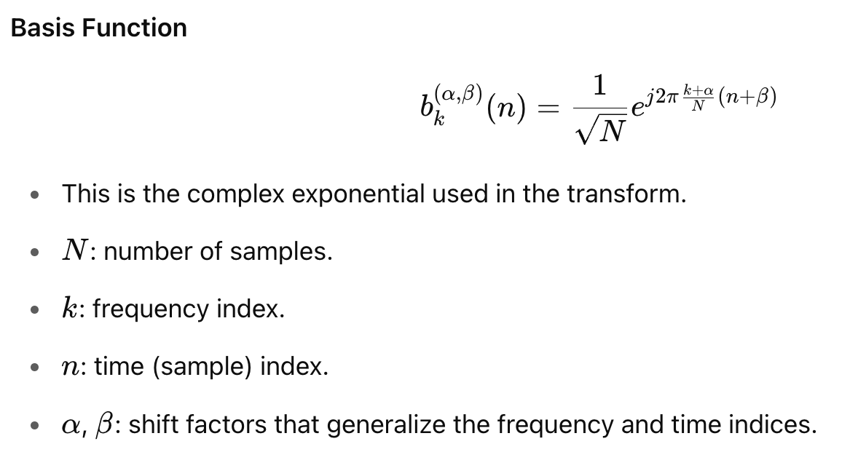
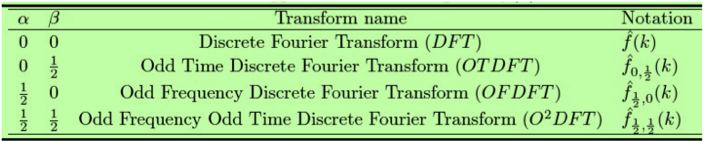
Generalized Discrete Fourier Transform (GDFT)
The Generalized Discrete Fourier Transform (GDFT) introduces two parameters:
α: modifies the frequency side.
β: modifies the time side.
These parameters allow us to create variations of the traditional DFT with different symmetry properties, which is useful in certain signal/image processing tasks.
Why do these matter?
These different forms:
Help improve symmetry in signals.
Are used in Fourier-based filtering, compression, and feature extraction.
Can align better with certain even/odd properties of signals

Slide 18
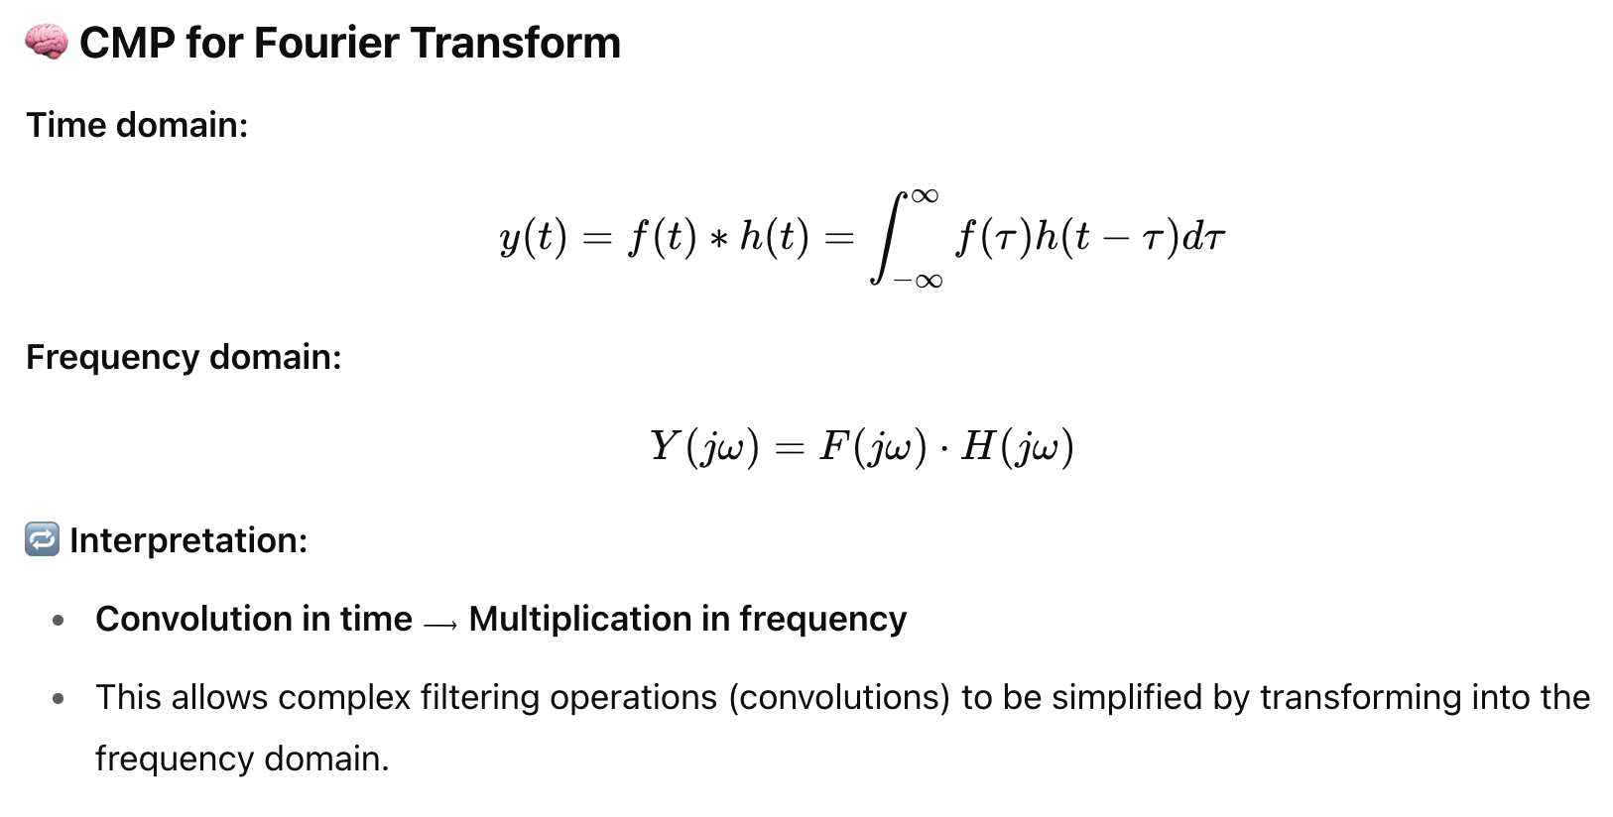
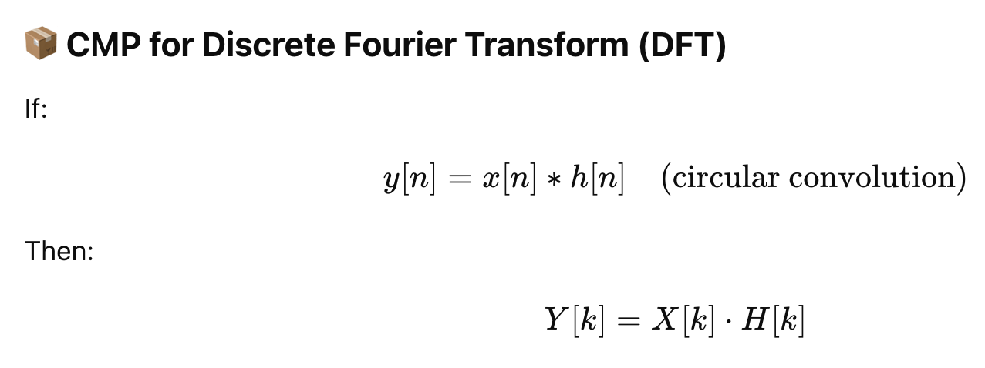
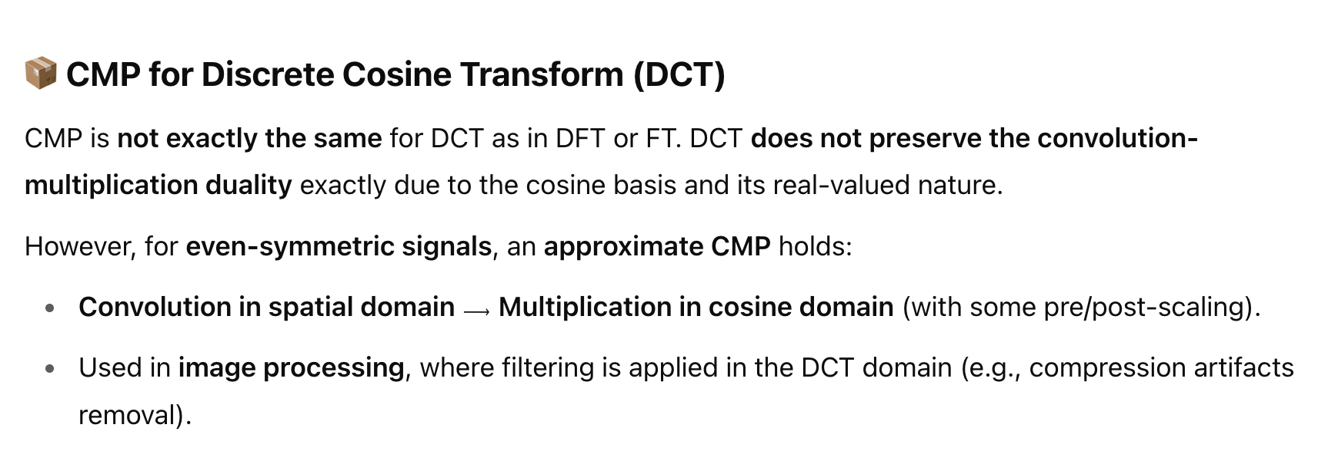
Convolution Multiplication Property (CMP)
The Convolution Multiplication Property (CMP) is a fundamental principle in signal processing and transform theory. It describes how convolution in one domain (time or space) becomes multiplication in the frequency domain, and vice versa.

Slide 19
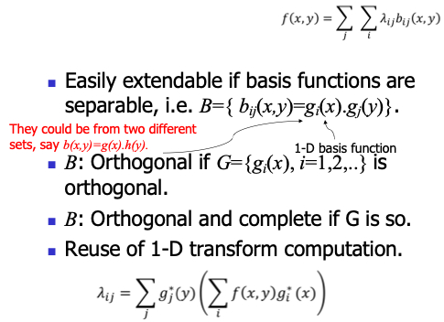
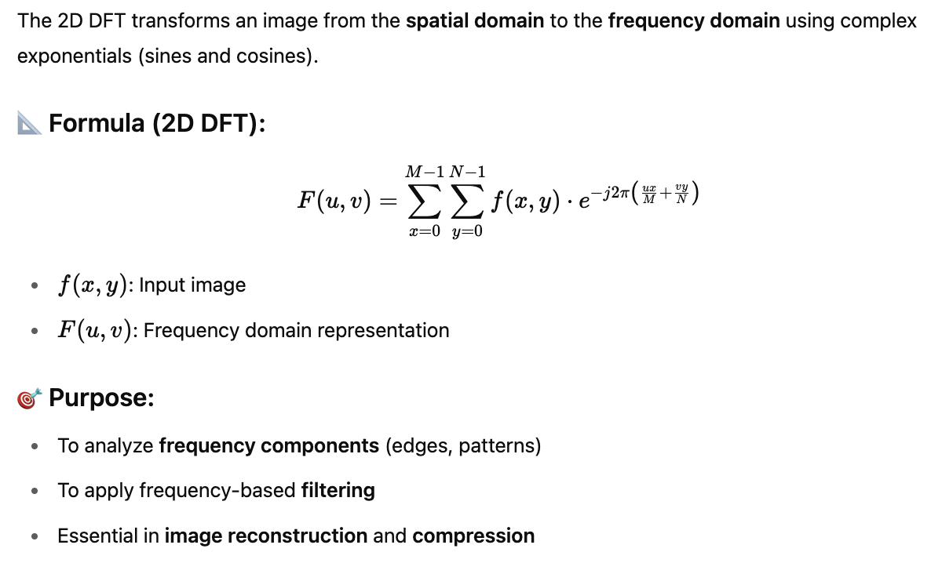
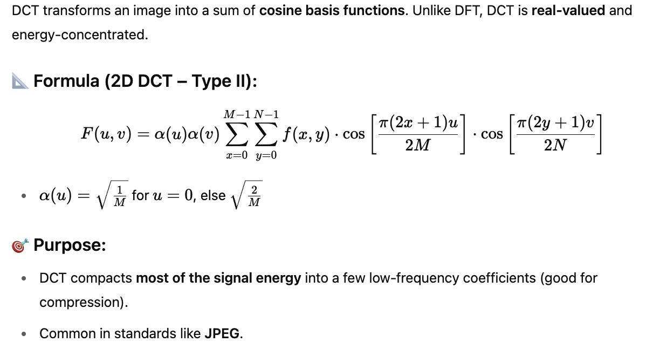
2-D Transforms
A 2D transform is the two-dimensional extension of a 1D transform, used for images (which are 2D signals).
Purpose:
To analyze spatial frequency in both horizontal and vertical directions.
2-D Image Transforms
An image transform converts an image from one domain (usually the spatial domain: pixels and intensities) to another domain (usually frequency domain). This helps to analyze, compress, or enhance the image based on its frequency components.
DFT in Image Processing
DCT in Image Processing

Slide 20
Overview of Key Transform Terms in Signal & Image Processing
Term | Domain | Description | Key Use
Image Transform | Any | Converts an image to another domain (e.g., frequency) | Analysis, compression, filtering
Orthogonal Expansion | Varies | Represents a signal/image as a sum of orthogonal basis functions | Compression, simplification
1D Transform | 1D Signal | Applies transform to 1D signals (e.g., sound, image rows) | Audio processing, row-wise image ops
Fourier Transform (FT) | Continuous | Transforms a continuous signal from time to frequency domain using sine/cosine basis | Frequency analysis
Discrete Linear Transform | Discrete | Any linear transform applied on sampled data | Foundation for DFT, DCT, DWT, etc.
DFT (Discrete Fourier Transform) | Discrete | Converts digital signal/image to frequency domain with complex output (sine + cosine basis) | Filtering, frequency analysis
DCT (Discrete Cosine Transform) | Discrete | Real-valued transform using only cosine basis | JPEG compression, energy compaction
2D Transform | Image | Applies transform in both dimensions of an image (rows & columns) | Image compression, filtering
2D DFT | Image | 2D frequency representation using sine/cosine components | Spectral analysis, filtering in image domain
2D DCT | Image | 2D cosine transform ideal for energy compaction | JPEG and MPEG compression
CMP (Convolution Multiplication Property) | Time & Frequency | Convolution in time ↔ multiplication in frequency domain (and vice versa) | Efficient filtering, signal systems
Analogy to Remember
Think of image transforms as changing perspective:
Spatial domain: you see where the changes happen (edges, lines).
Frequency domain: you see how fast the changes happen (high or low frequencies).

Slide 21
Topics on which Week 1 Assignment Questions are based
Image
Geometric Definition of Image
Image Processing Concepts and Operations
Image Transforms

Slide 22

QUESTION 1
SOLUTION 1
Pixel | Frequency | Cumulative Sum | Normalized Sum | New Pixel
0 | 3 | 3 | 0.72 | 1
1 | 3 | 6 | 1.44 | 1
2 | 5 | 11 | 2.64 | 3
3 | 4 | 15 | 3.60 | 4
4 | 3 | 18 | 4.32 | 4
5 | 3 | 21 | 5.04 | 5
6 | 4 | 25 | 6.00 | 6
Computation of Histogram equalization is shown in the following table.
According to the above table pixel value 3 becomes 4. Hence, 4 is the answer.
CORRECT ANSWER 1
c)

Slide 23

QUESTION 2
Note: Note that the probability of a normal variable P(z > 2.5) = 0.062. X is a normally distributed variable with mean μ = 30 and standard deviation σ = 4. Compute P(X < 40).
a) 0.0238
b) 0.9380
c) 0.1538
d) 0.0918
SOLUTION 2
CORRECT ANSWER 2
b)

Slide 24




QUESTION 3
SOLUTION 3
CORRECT ANSWER 3
a)

Slide 25



QUESTION 4
An image taken using a camera can be enhanced by different techniques. Suppose, a software is developed which can detect if an image has been enhanced or not with 96% accuracy. A survey is done, and it is found that 75% of all images are enhanced. If the software predicts that an image is enhanced, what is the probability that the image is actually enhanced?
a) 0.9663
b) 0.9930
c) 0.9863
d) 0.5940
SOLUTION 4
CORRECT ANSWER 4
c)

Slide 26






QUESTION 5
SOLUTION 5
Alternatively
CORRECT ANSWER 5
a)

Slide 27


QUESTION 6
Consider a binary image with a small fully filled white circle on a black background. How does this image look like after applying image gradient operation?
a) Same as the original image
b) A thin line surrounding the boundary of that fully filled white circle
c) A thin line surrounding the boundary of whole image
d) An image with a white dot at the center
SOLUTION 6
CORRECT ANSWER 6
b)

Slide 28





QUESTION 7
Consider the following 3-bit grey scale image
What is the value when vertical Sobel operator and horizontal Sobel operator are applied on the orange colored pixel?
a) 0 and 2
b) 7 and -3
c) 10 and 2
d) 2 and 10
SOLUTION 7
CORRECT ANSWER 7
b)

Slide 29




QUESTION 8
SOLUTION 8
CORRECT ANSWER 8
b), d)

Slide 30

QUESTION 9
Consider a 3-bit grey scale image with dimension 32 × 32. What will be the range of values in its X-axis?
a) 0 to 7
b) 1 to 7
c) 0 to 15
d) 0 to 255
SOLUTION 9
CORRECT ANSWER 9
a)

Slide 31




QUESTION 10
Consider the following 3-bit grey scale image
What is the value when horizontal Prewitt operator and vertical Prewitt operator are applied on the orange colored pixel?
a) 0 and 2
b) −4 and −2
c) 4 and −2
d) −4 and 2
SOLUTION 10
CORRECT ANSWER 10
c)

